Slide 1
Crater Lake History
Built on older shield volcano
Growth of Mt. Mazama composite volcano
Glacial erosion (concurrent with volcanism)
Explosion craters fill with domes
Massive eruption of Mt. Mazama and subsequent caldera formation
Resurgent volcanism in caldera
Notes:
The trend towards silica-enrichment which had started in the magma beneath Mt. Mazama over 400,000 years ago, was by 30,000 years ago reaching it’s final stage. The dangerous gas-trapping character of silica-rich magma was beginning to cause increasingly explosive eruptions that were followed by thick flows and dome formation.

Slide 2
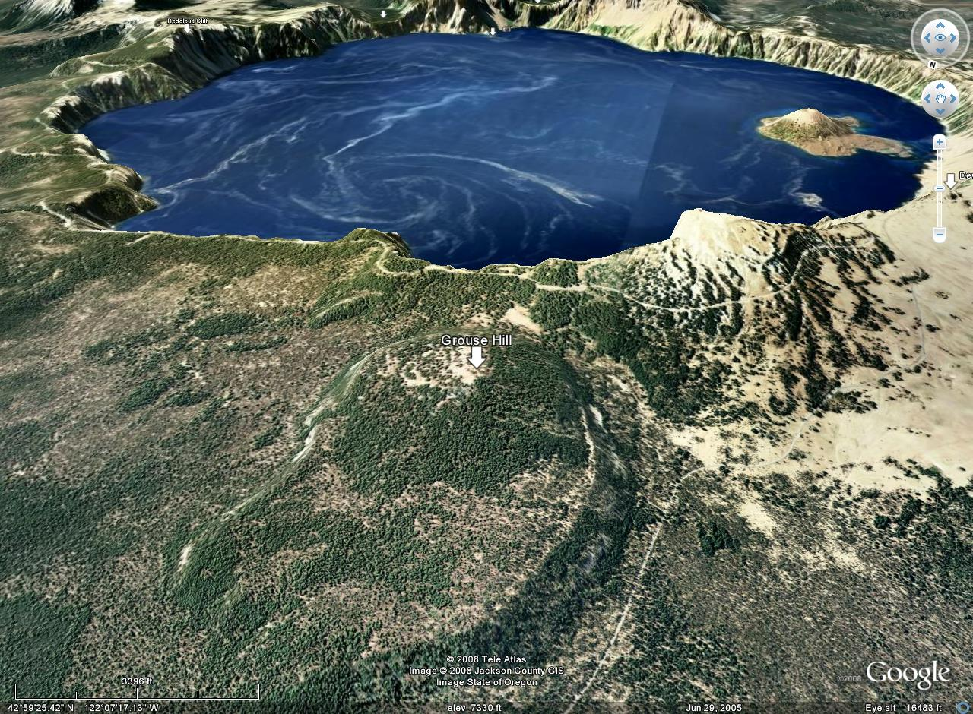
Redcloud Cliff
Grouse Hill
Notes:
Grouse Hill and Redcloud Cliff are comprised of thick lava flows erupted between 30,000 and 25,000 years ago respectively.

Slide 3
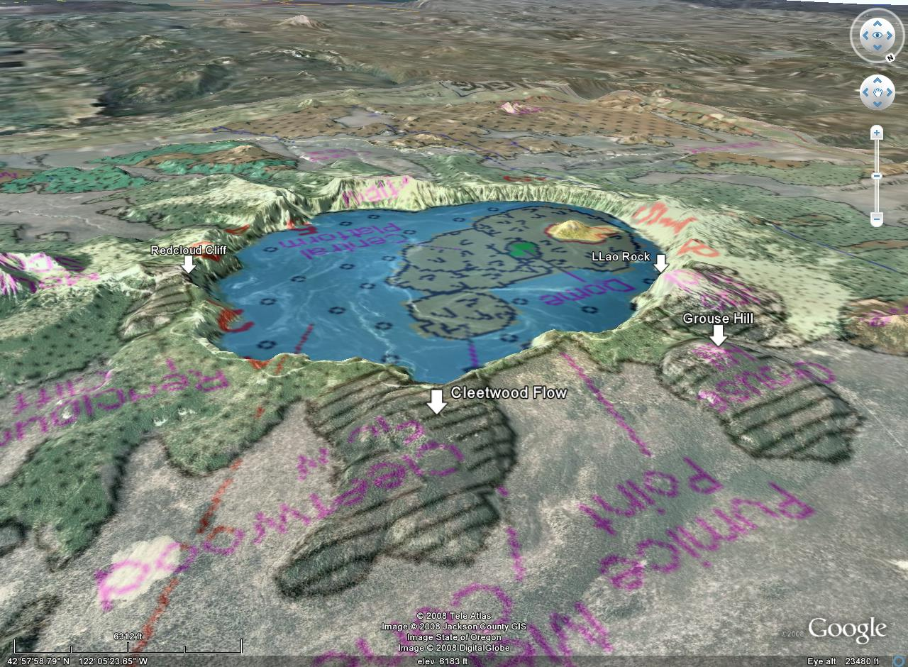
Notes:
Other silica-rich flows which preceded and forewarned the climactic eruption of Mt. Mazama included the Cleetwood Flow and Llao Rock.

Slide 4
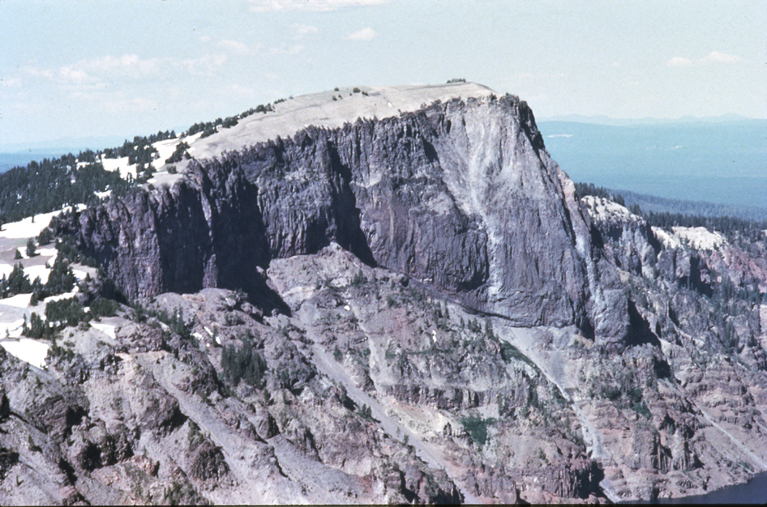
“Llao Rock” (dome filling Mazama explosion crater)
Notes:
The violent eruption that ultimately formed Llao Rock happened about 7,900 years ago…

Slide 5
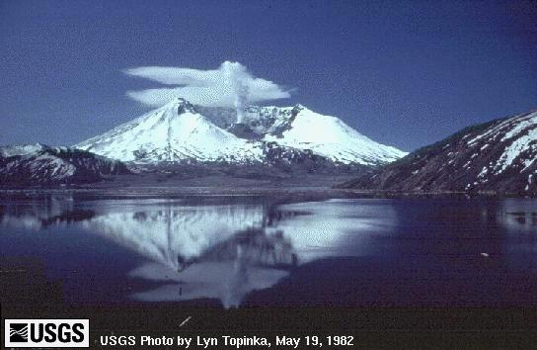
Notes:
… by first blasting out an explosion crater towards the summit of Mt. Mazama similar to that created by the eruption of Mt. St. Helens in 1980.

Slide 6
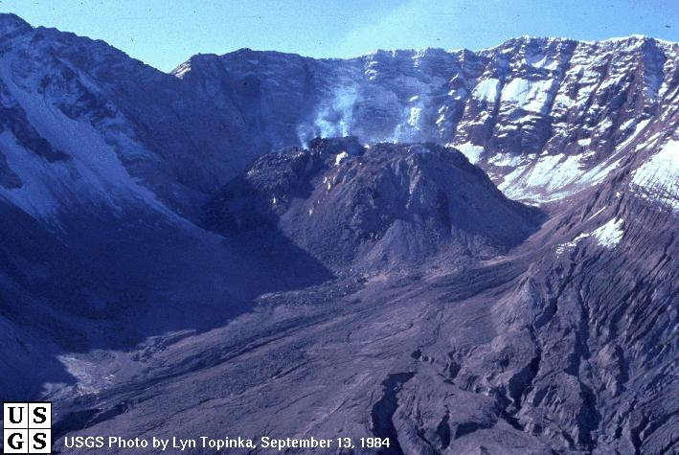
Dome filling explosion crater of Mt St Helens
Notes:
A thin veneer of pyroclastics blanketed the base of the crater, over which a volcanic dome grew.

Slide 7
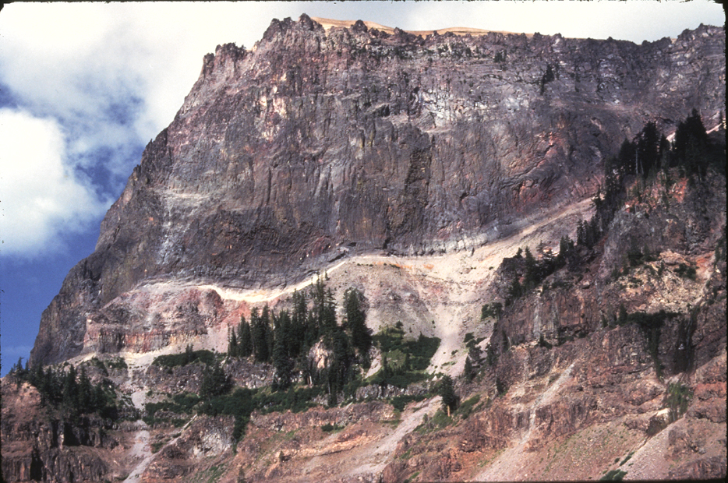
Llao Rock close up
Notes:
In a similar fashion, a white layer of pumice and ash covered the floor of a Mt. Mazama explosion crater, that soon thereafter was filled by the thick rhyodacite lava flow of Llao Rock.

Slide 8
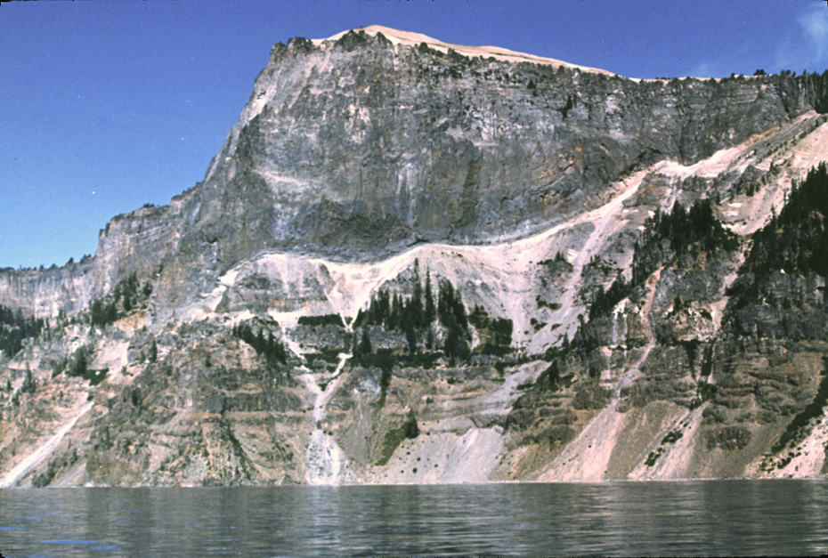
Llao Rock again
Notes:
Within 200 years of the eruption at Llao Rock, …

Slide 9
Notes:
… another thick lava flow erupted near present-day Cleetwood Cove. These eruptions reached a peak 7,700 years ago …

Slide 10
Crater Lake History
Built on older shield volcano
Growth of Mt. Mazama composite volcano
Glacial erosion
Explosion craters fill with domes
Massive eruption of Mt. Mazama and subsequent caldera formation
Resurgent volcanism in caldera
Notes:
… in the largest explosive eruption in the Cascades during the past 1 million years.

Slide 11
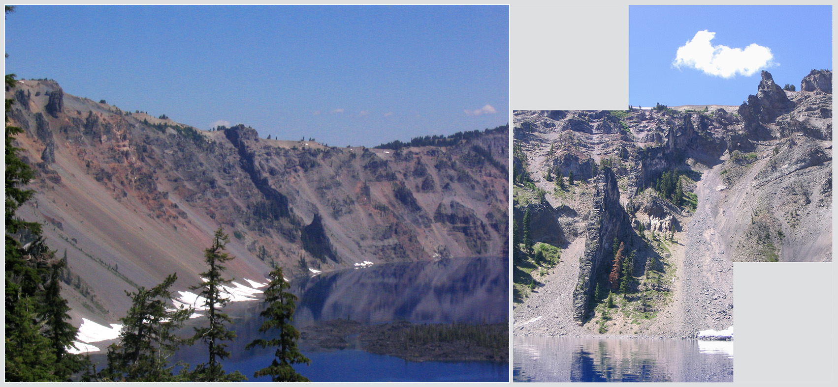
“Devil’s Backbone” (radial andesite dike)
Notes:
During the final stages of Mt. Mazama's existence, pressures within the mountain caused large, radial cracks to form within it. In some instances those cracks were forced open and filled with hot, molten rock that later cooled and crystallized into huge vertical slabs of resistant rock, forming what geologists call radial dikes. Devil's Backbone is one of those dikes, …

Slide 12
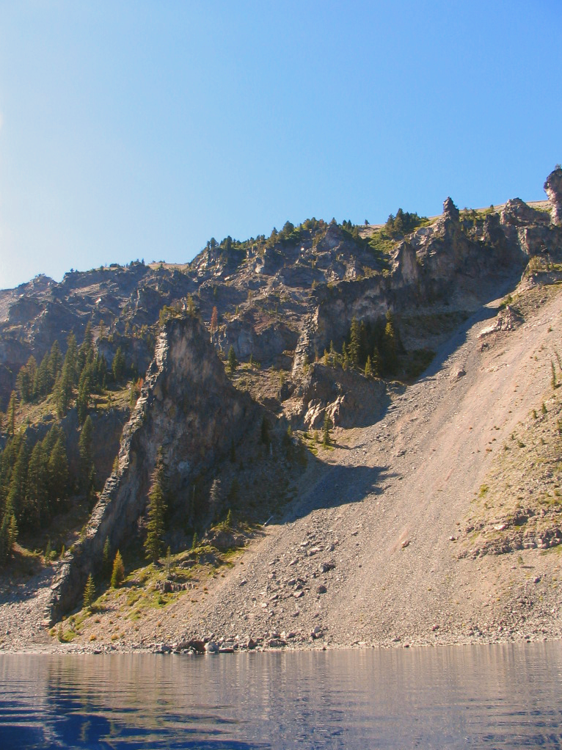
“Devil’s Backbone” (andesite dike)
Notes:
… standing tall and strong on the western shore of Crater Lake as the softer pumice and lava flows that once enclosed it weather away.

Slide 13
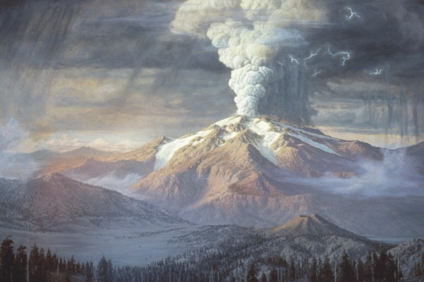
Notes:
The cataclysmic eruption of Mount Mazama 7,700 years ago started from a single vent on the northeast side of the volcano as a towering column of pumice and ash that reached some 30 miles (50 km) high. Winds carried the ash across much of the Pacific Northwest and parts of southern Canada. Native Americans witnessed the event and believed it was the battle between Llao the chief of the below world who lived in Mazama’s interior, and Skell, the Chief of the Above World who lived in Mt. Shasta in northern California.

Slide 14
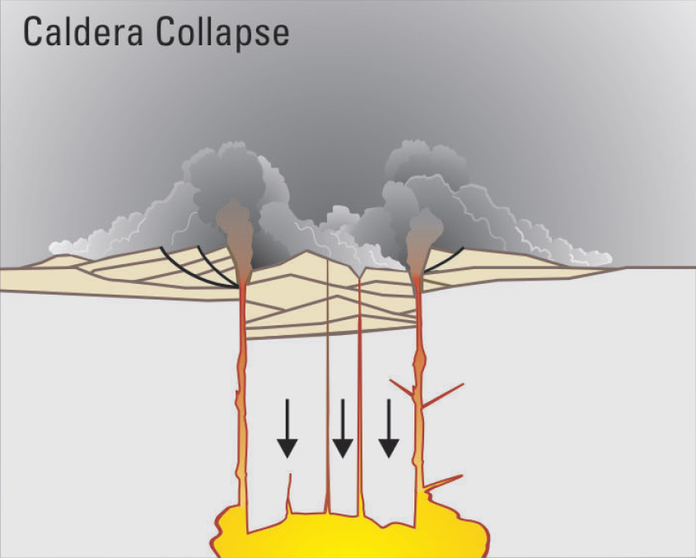
Notes:
As more magma was erupted, cracks opened up around the summit, which began to collapse. Fountains of pumice and ash surrounded the collapsing summit, and pyroclastic flows raced down all sides of the volcano.

Slide 15
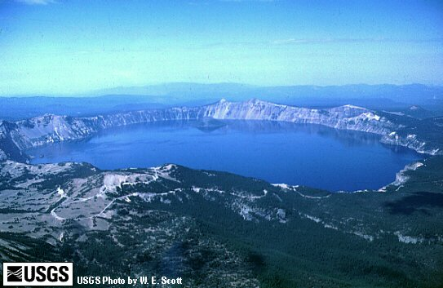
Cone volume = 1/3 pi r² h
1500 m
9 km
Notes:
If we assume that the top of the mountain dropped into a void in the underlying magma chamber at least equal to its own volume, and that the void was created by the eruption of a large amount of magma, we can use the equation for the volume of a cone to get a rough idea as to how much magma was erupted.

Slide 16
Cone volume = 1/3 X 3.14 X 4500m² X 1500m =
31,808,696,819m³ = 32 km³
1500 m
9 km
Notes:
Plugging in all the numbers gives us about 32km³.

Slide 17
Volcano | Country | Year | Cubic km erupted
Tambora | Indonesia | 1815 | 100
Taupo | New Zealand | 186 AD | 100
Kurile Lake | Kamchatka, Russia | 6640 BC | 70-80
Aniakchak | Alaska | 3450 yr ago | 50
Crater Lake | USA | 6850 ago | 30-40
Kikai-Akahoya | Japan | 6300 ago | 30-40
Kuwae | Vanuatu | 1452 | 32-39
Santorini | Greece | 3600 ago | 30-33
Ambrym | Vanuatu | 50 AD | 19-25
Krakatau | Indonesia | 1883 | 18
Katmai | Alaska | 1912 | 12
Pinatubo | Philippines | 1991 | 10
32 km3
Notes:
… which falls nicely within the range given for Crater Lake, and puts it tied for the fifth largest eruption of the Holocene.

Slide 18
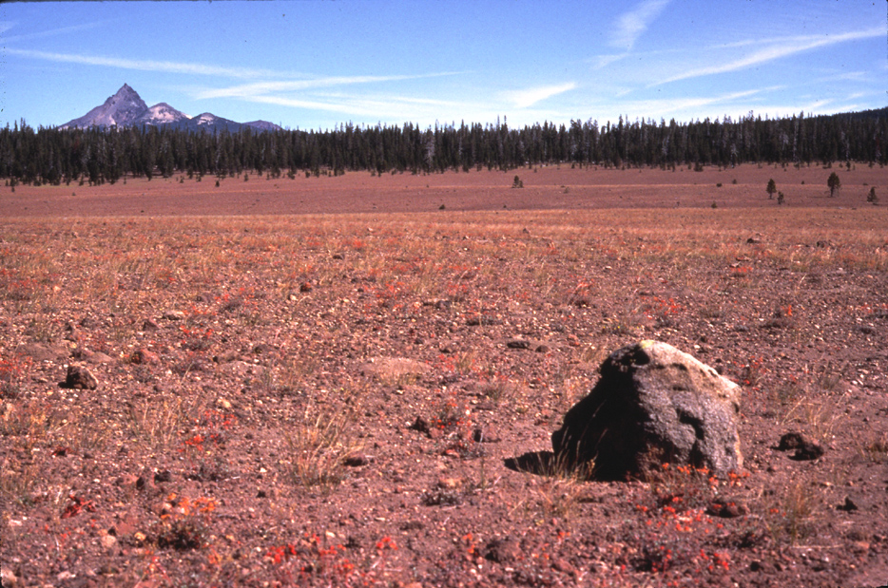
Pumice Desert (Mt. Mazama’s handiwork)
Notes:
The colossal eruption blanketed a vast area with silica-rich, nutrient-poor pyroclastics. Since little grows here, the area is known as the pumice desert.

Slide 19
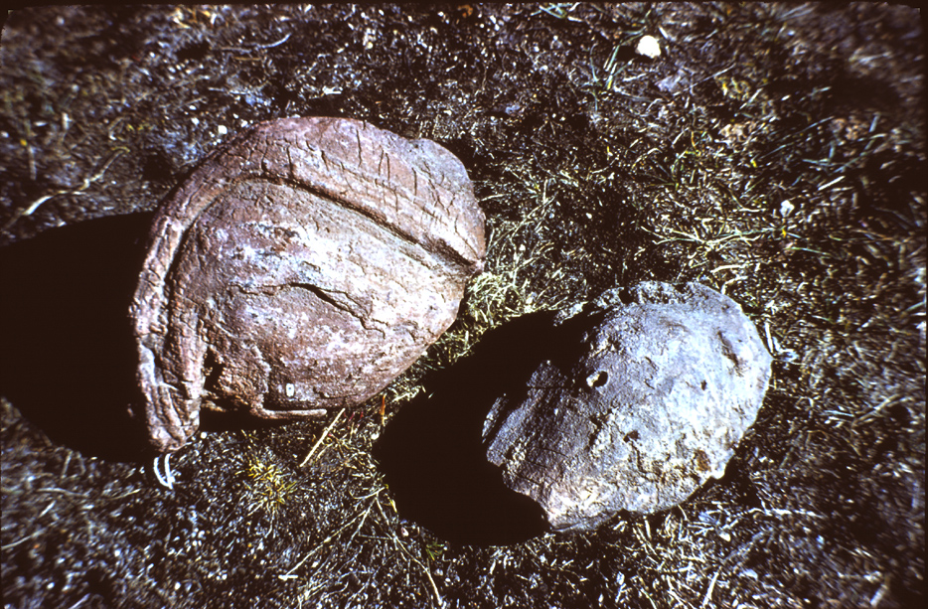
Lava bombs
Notes:
Some of the larger clots of magma hurled into the air were streamlined by air resistance into lava bombs.

Slide 20
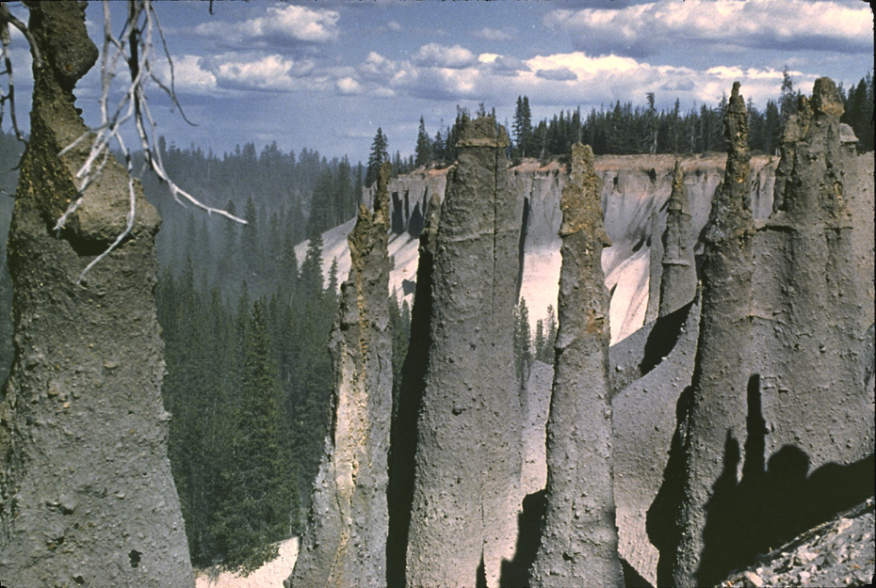
The Pinnacles (fumarole-altered pyroclastics)
Notes:
The Pinnacles formed as larger pyroclasts settled on finer ash deposits and protected them from erosion. The ash here has been altered by fumarole activity.

Slide 21
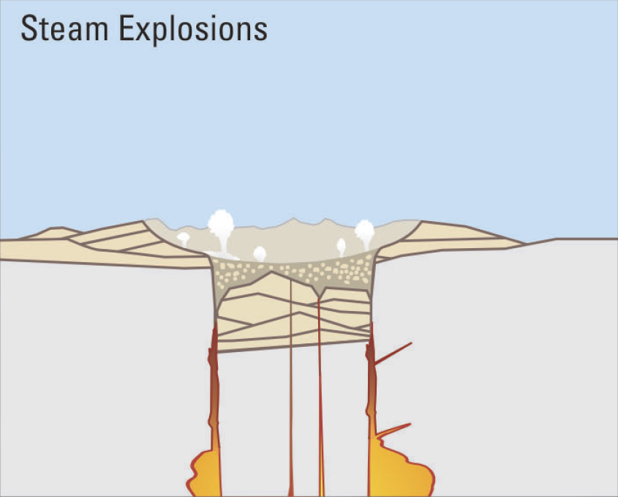
Notes:
When the dust had settled, the new caldera was 5miles(8km) in diameter and 1 mile(1.6km) deep. Ground water interacted with hot deposits causing explosions of steam and ash.

Slide 22
Crater Lake History
Built on older shield volcano
Growth of Mt. Mazama composite volcano
Glacial erosion (concurrent with volcanism)
Explosion craters fill with domes
Massive eruption of Mt. Mazama and subsequent caldera formation
Resurgent volcanism in caldera
Notes:
The massive eruption of Mt. Mazama removed a lot, but not all of the magma from the chamber. At this point Mt. Mazama entered a phase typical of composite volcanoes that experience large eruptions known as resurgent volcanism, where some of the remaining magma is erupted shortly after the main eruption. For Mt. Mazama this phase lasted about 750 years.

Slide 23
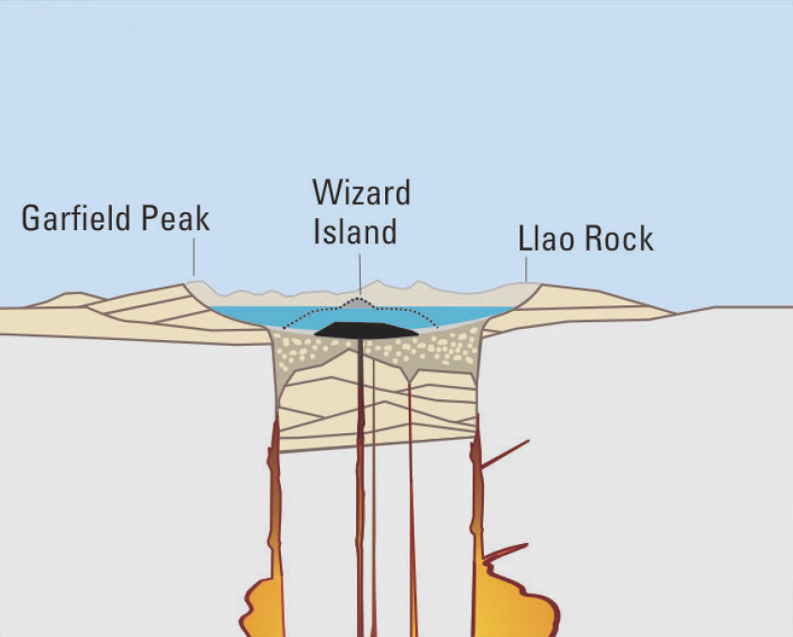
Gas depleted magma
Notes:
Since the cataclysmic eruption released most of the gas in the magma chamber, the resurgent events erupted relatively gas-depleted magma and were therefore far less violent.

Slide 24
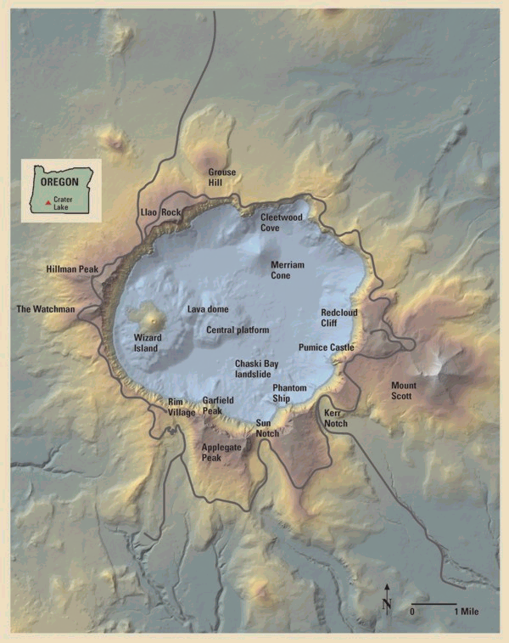
Notes:
The resurgent eruptions utilized new vents within the caldera and built the base of Wizard Island, Merriam Cone, and the central platform.

Slide 25
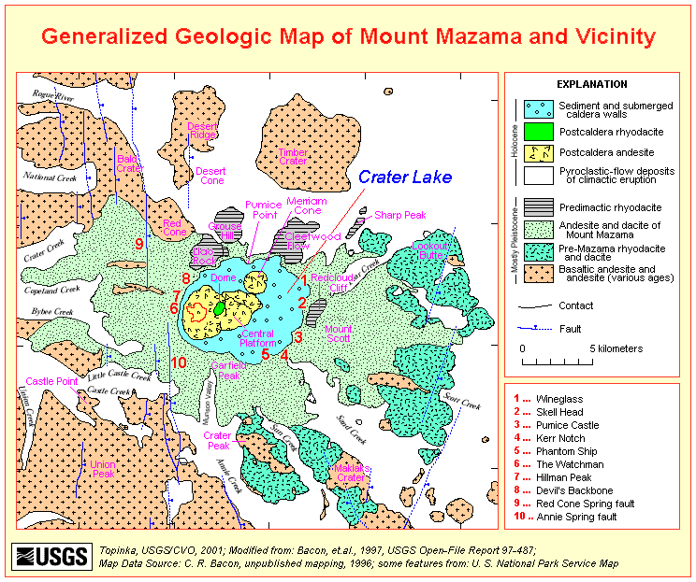
Merriam Cone
Wizard Island
Central Platform
Notes:
Although the magma composition was uniformly andesitic for each of these features, …

Slide 26
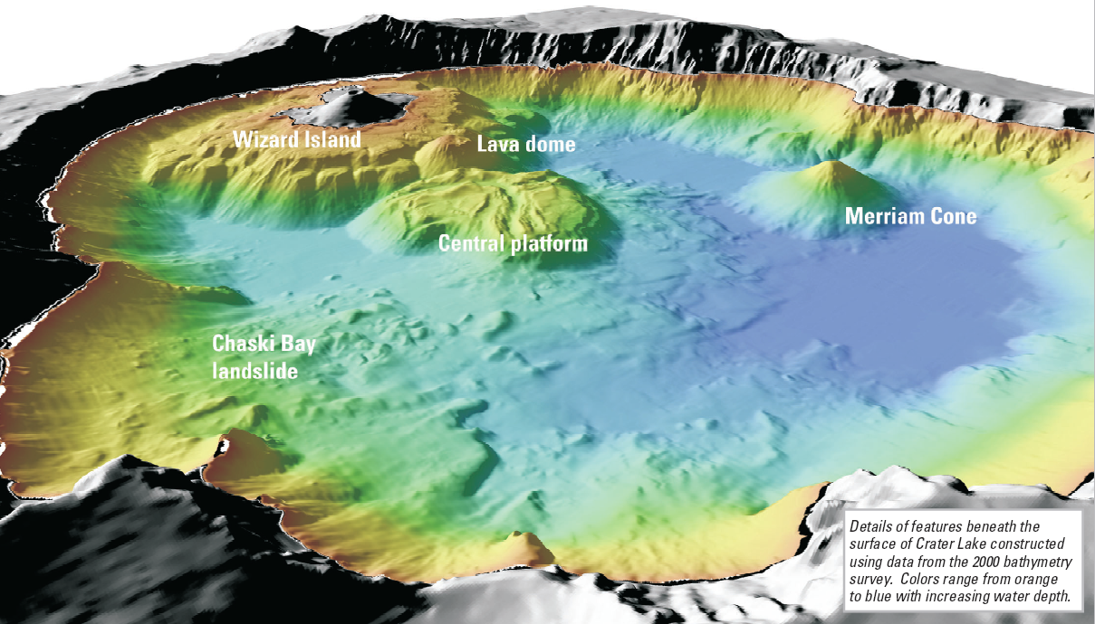
Notes:
… their shapes vary because they formed at different lake levels as rain and snowmelt filled the caldera. The Central platform and base of Wizard Island are relatively flat on top because they formed from lava that erupted above the lake level and then flowed towards the surrounding shoreline where it solidified. Notice the two terraces in the base of Wizard Island. The highest and broadest of the two formed from eruptions that took place when the lake level was very near the present level while the lower terrace formed at lower lake levels. Merriam Cone and Lava dome have no such benches or terraces because they formed entirely below the water level. Sometime during, or probably after the resurgent phase of volcanism a large landslide surged across the caldera floor creating Chaski Bay in the process.

Slide 27
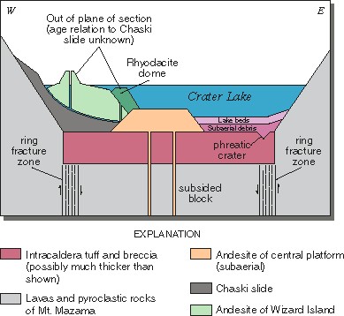
Notes:
Resurgent volcanism and sedimentation helped seal the lake such that lake levels rose faster, eventually submerging all of the resurgent features …

Slide 28
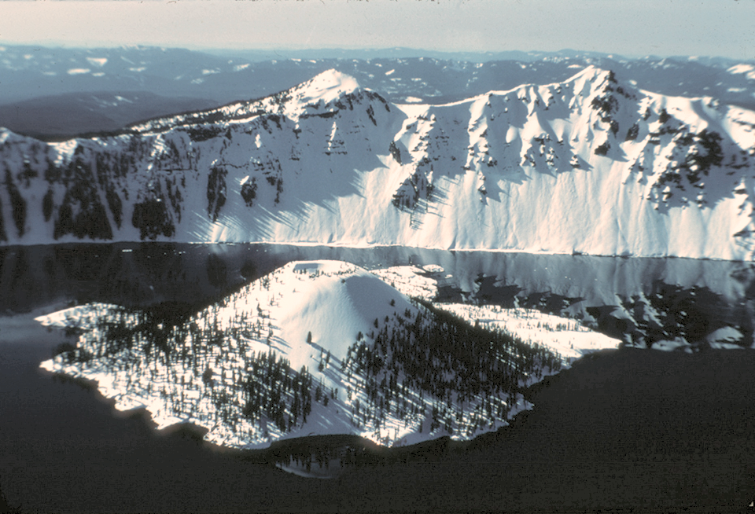
The only crater at Crater Lake
Notes:
… except for the top of Wizard Island. The last eruptions at Wizard Island took place when the lake was about 260 feet lower than today.

Slide 29
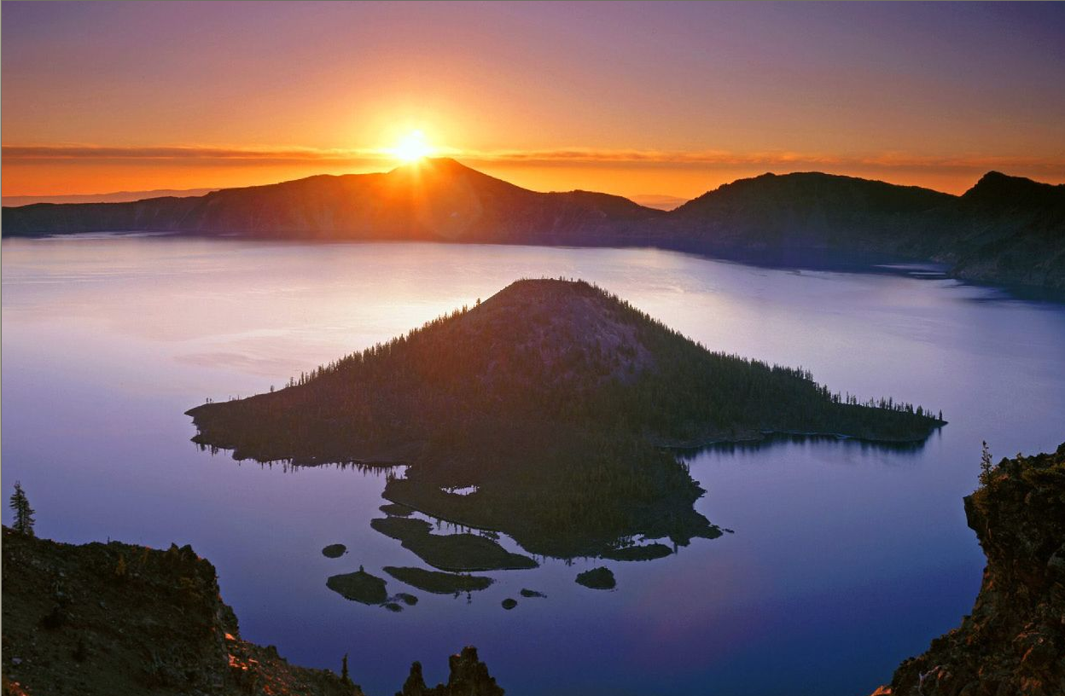
Lake level now in equilibrium
Porous layer
Notes:
The water level continued to rise until it encountered a thick layer of porous deposits in the northeast caldera wall. These deposits stabilize lake levels like an overflow drain in a bathtub.

Slide 30
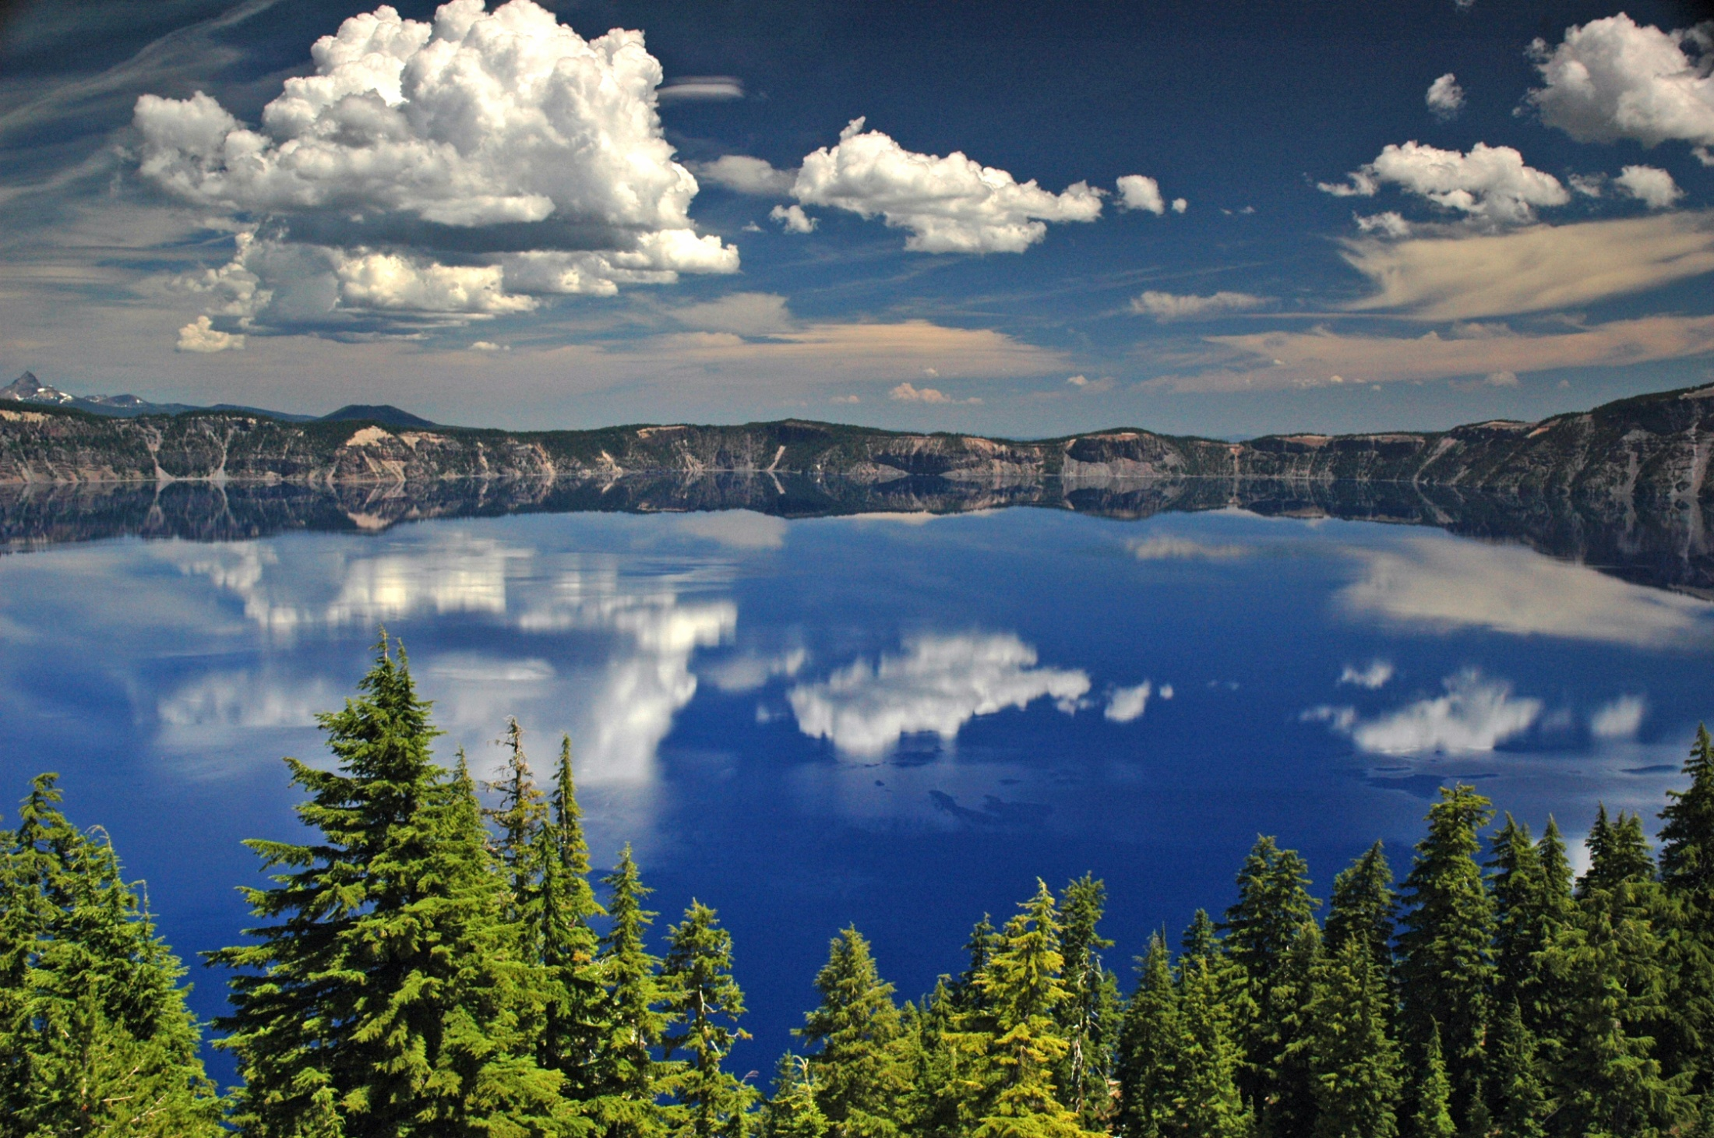
Notes:
Due to several unique factors, most prominently that it has no inlets or tributaries, the waters of Crater Lake are some of the purest in North America. The deep blue color for which the lake is famous comes from the fact that water molecules scatter mostly blue light and there are virtually no other particles in the lake to scatter other colors.

Slide 31
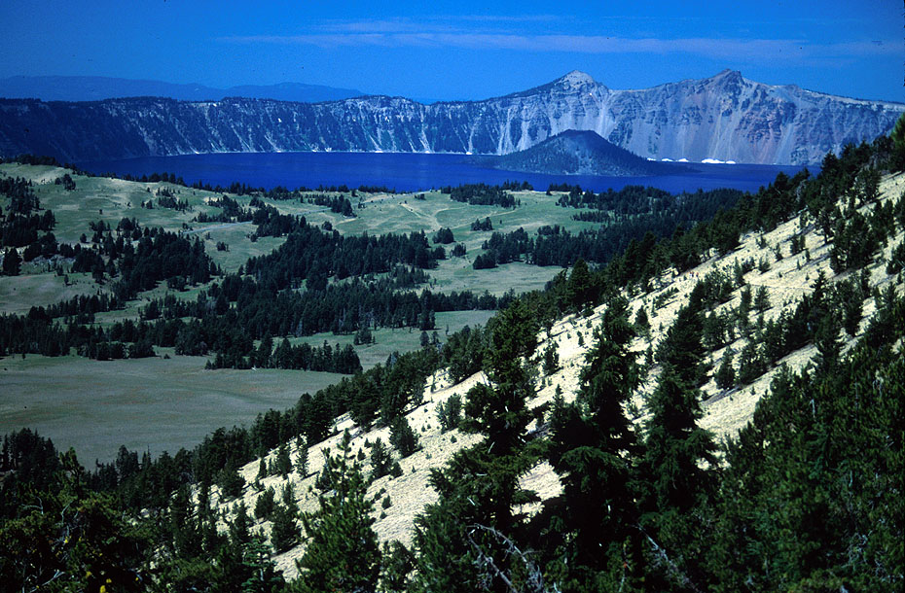
Notes:
Crater Lake NP3 SS View of Crater Lake from Mount Scott

Slide 32
Notes:
The collapse formed a tremendous depression which later filled with rain water to become one of the deepest lakes in the world. In fact it has the greatest average depth of any lake in the world whose basin lies entirely above sea level.

Slide 33
Notes:
You can seeBasaltic andesite from shield volcano

Slide 34
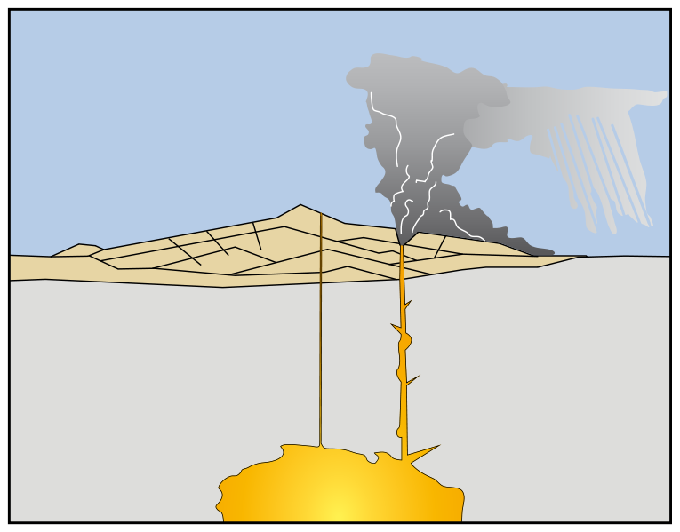
Notes:
The cataclysmic eruption started from a vent on the northeast side of the volcano as a towering column of ash, with pyroclastic flows spreading to the northeast. wiki

Slide 35
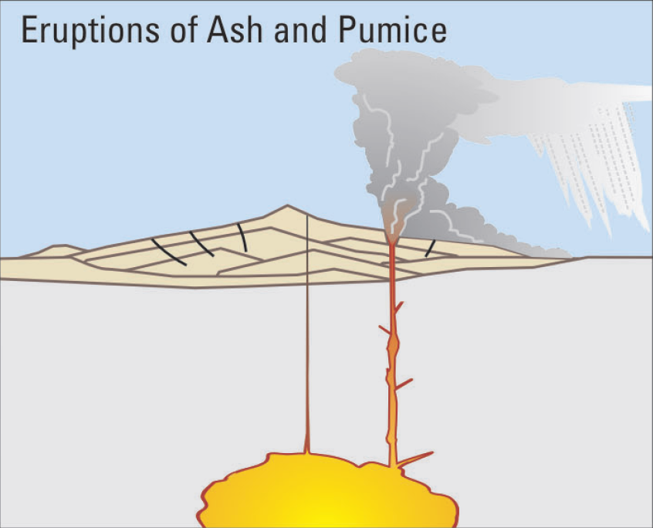
Notes:
Eruptions of ash and pumice: The cataclysmic eruption started from a vent on the northeast side of the volcano as a towering column of ash, with pyroclastic flows spreading to the northeast.

Slide 36
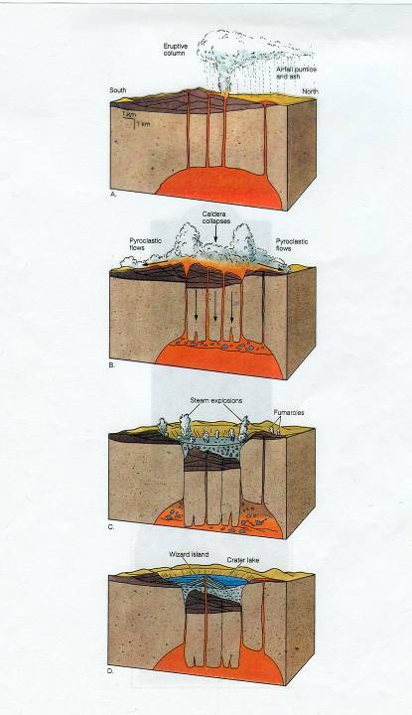
Catastrophic eruption of Mt. Mazama ~ 7,000 years ago

Slide 37
Caldera- depression resulting from collapse of volcanic structure

Slide 38
